Slide 1





A2209G-Group 2
VEHICLE SHOWROOM MANAGEMENT SYSTEM

Slide 2

A2209GGroup 2
DO HOANG AN (LEADER)
1
TRAN ANH TUAN
2
MEMBER
TRAN TUAN TU
3
DINH THE PHONG
4

Slide 3


A2209G-Group 2
DEVELOPMENT PLATFORM
The technologies we used in this project include:
Client:
ReactJs
Backend:
C# (ASP.NET Core Web API)

Slide 4
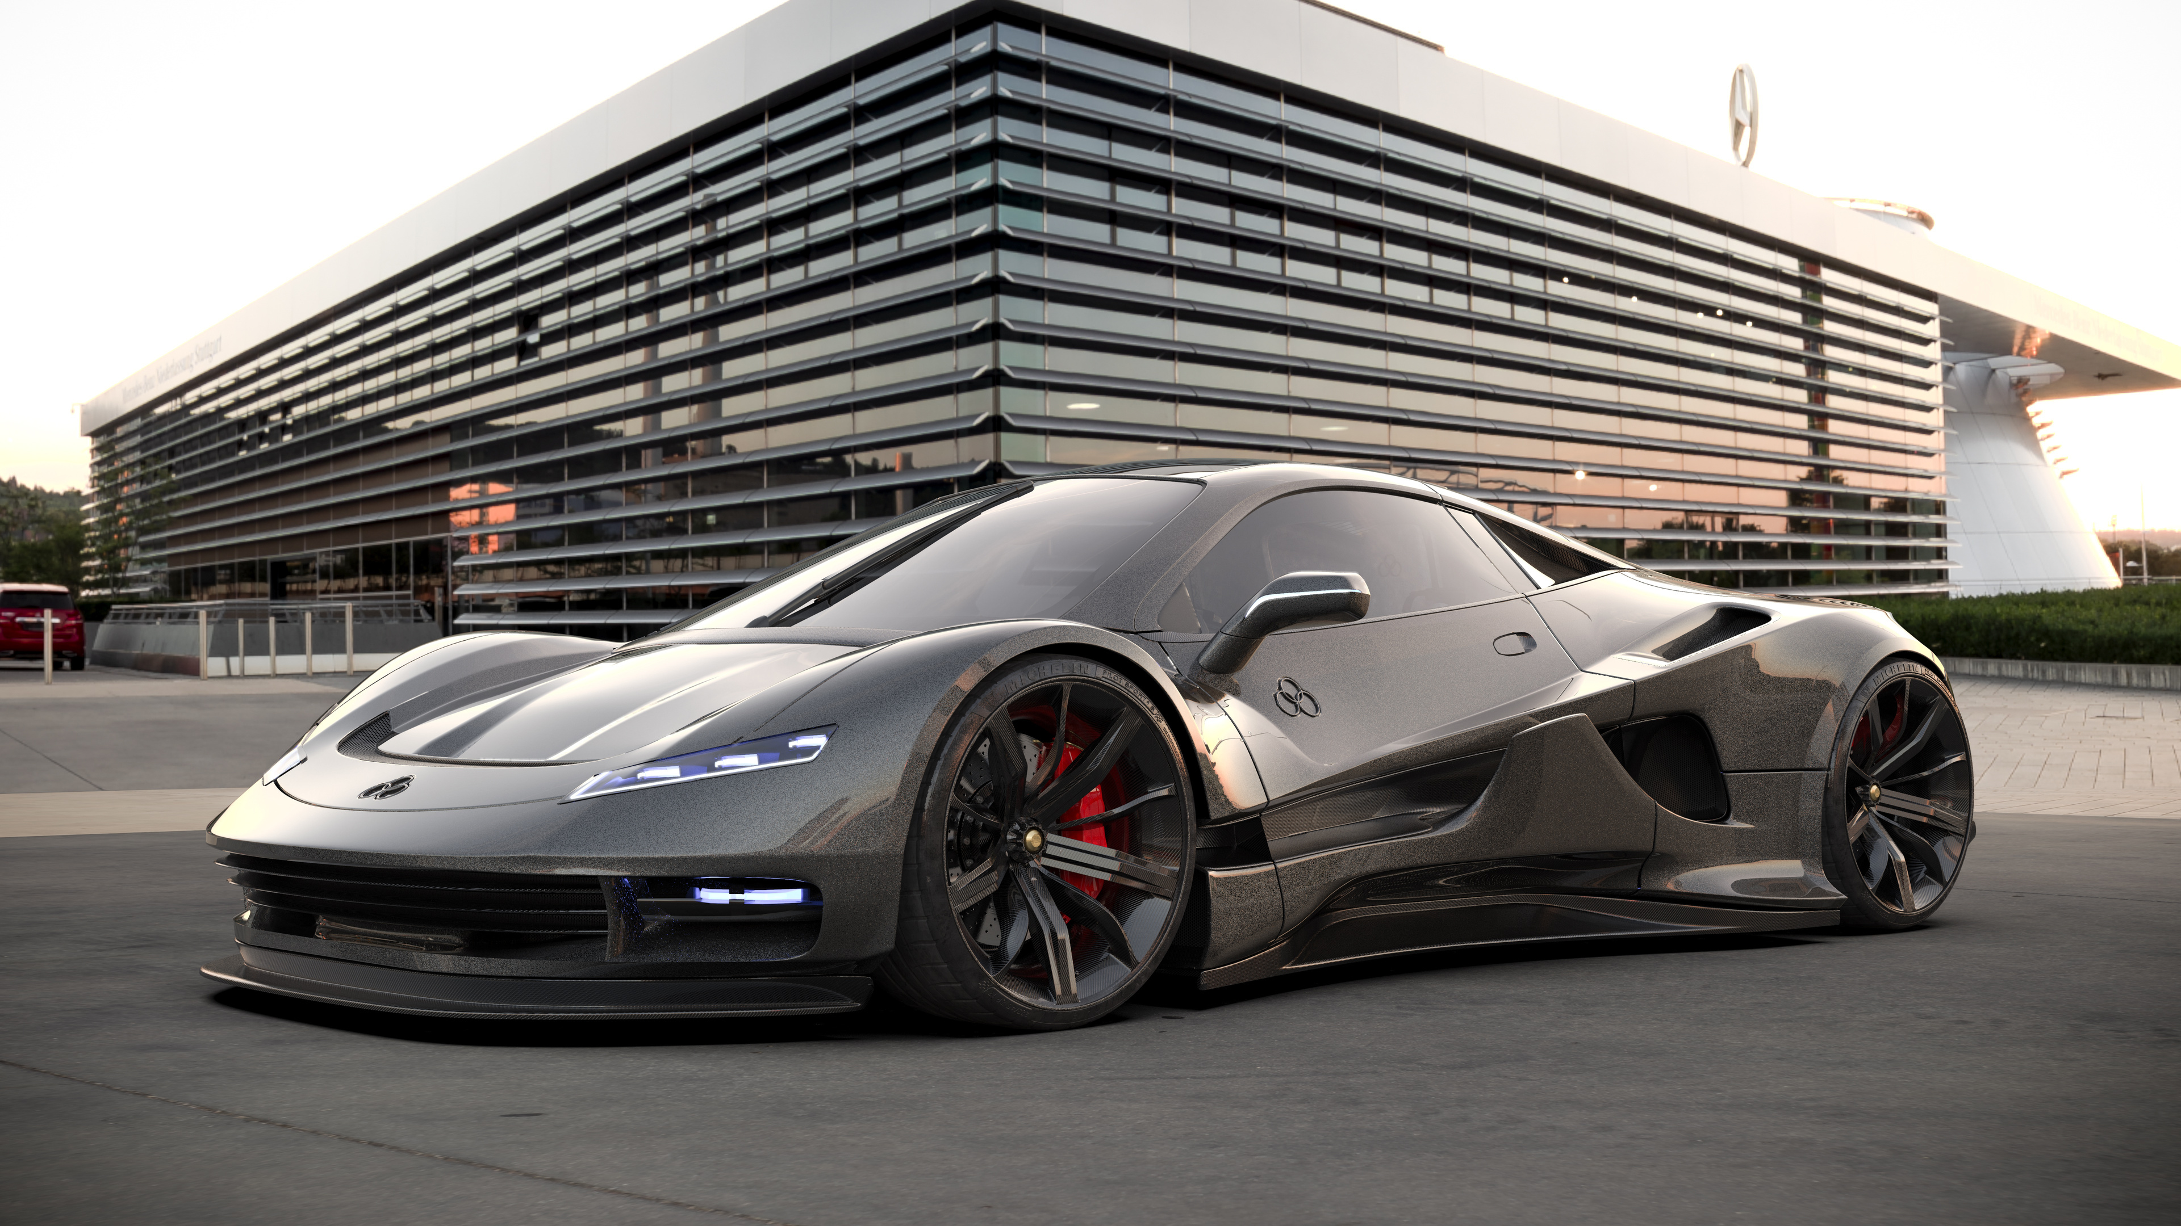
A2209G-Group 2
INTRODUCTION
Hello everyone, today I would like to introduce the car showroom management system that we have developed. This system is designed to optimize the operations of a car showroom, from customer management, car services, to sales and employee management.

Slide 5

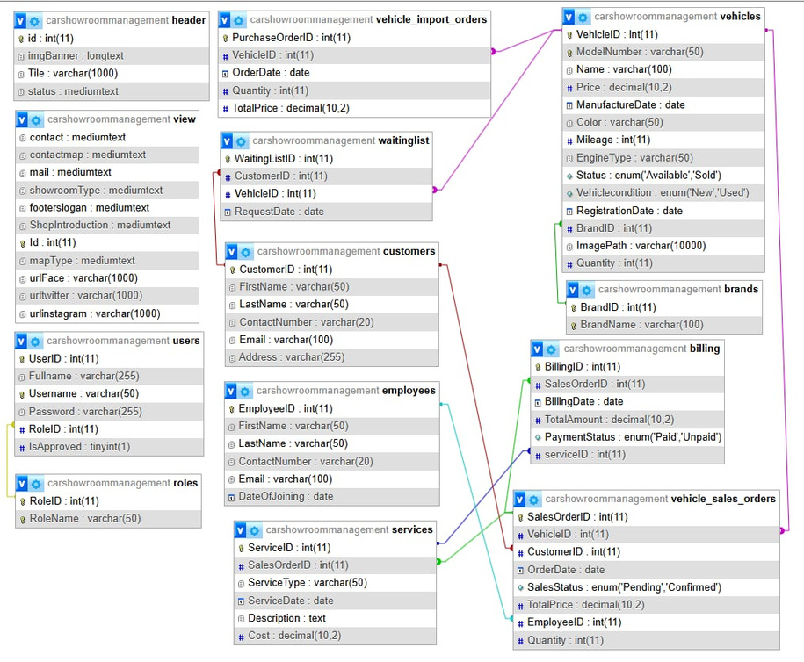
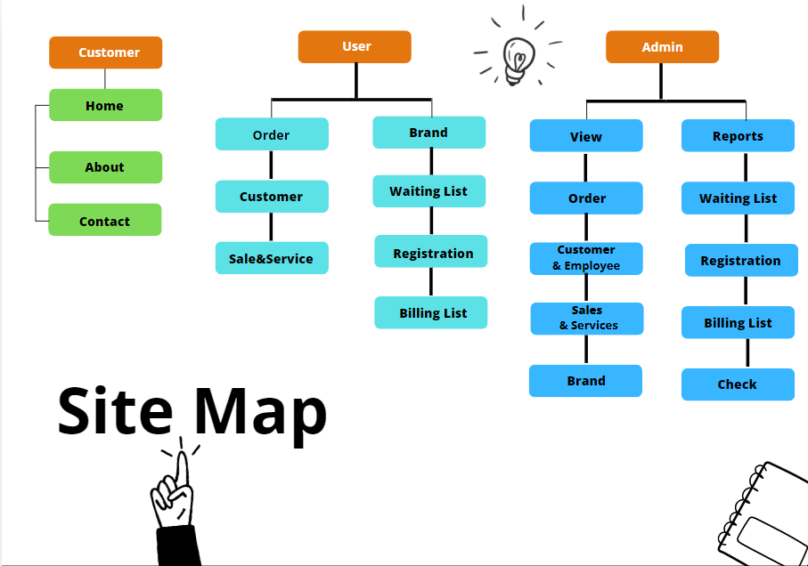
A2209G-Group 2
Site Map
Database

Slide 6

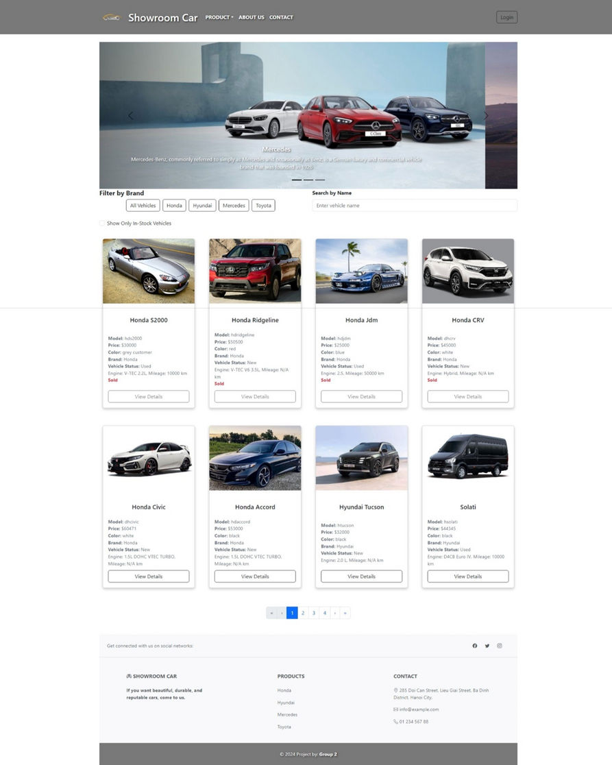
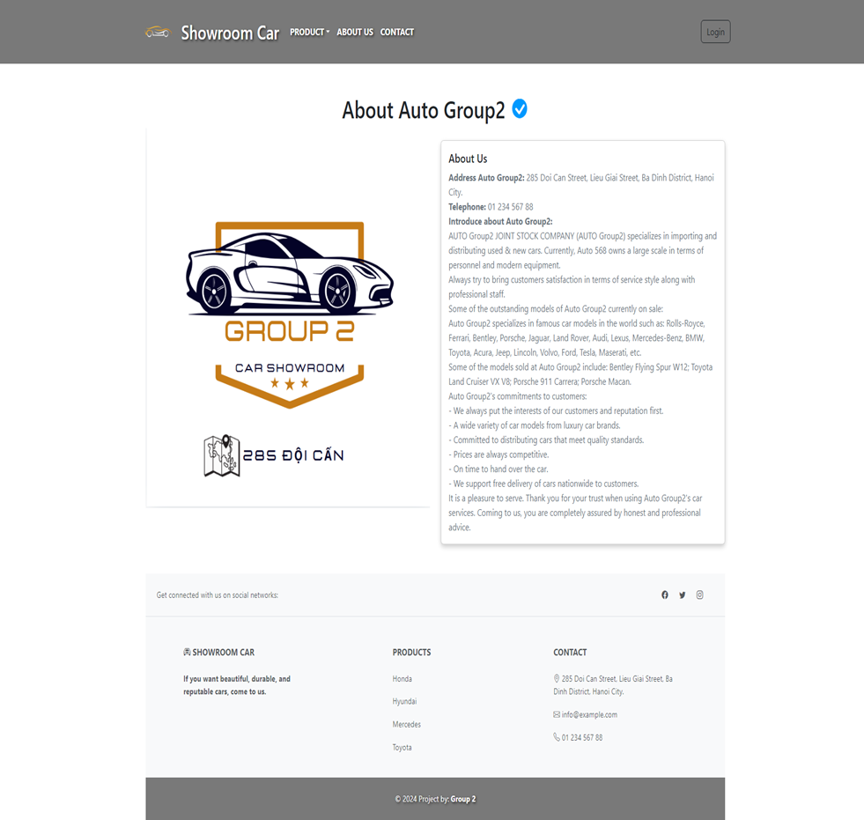
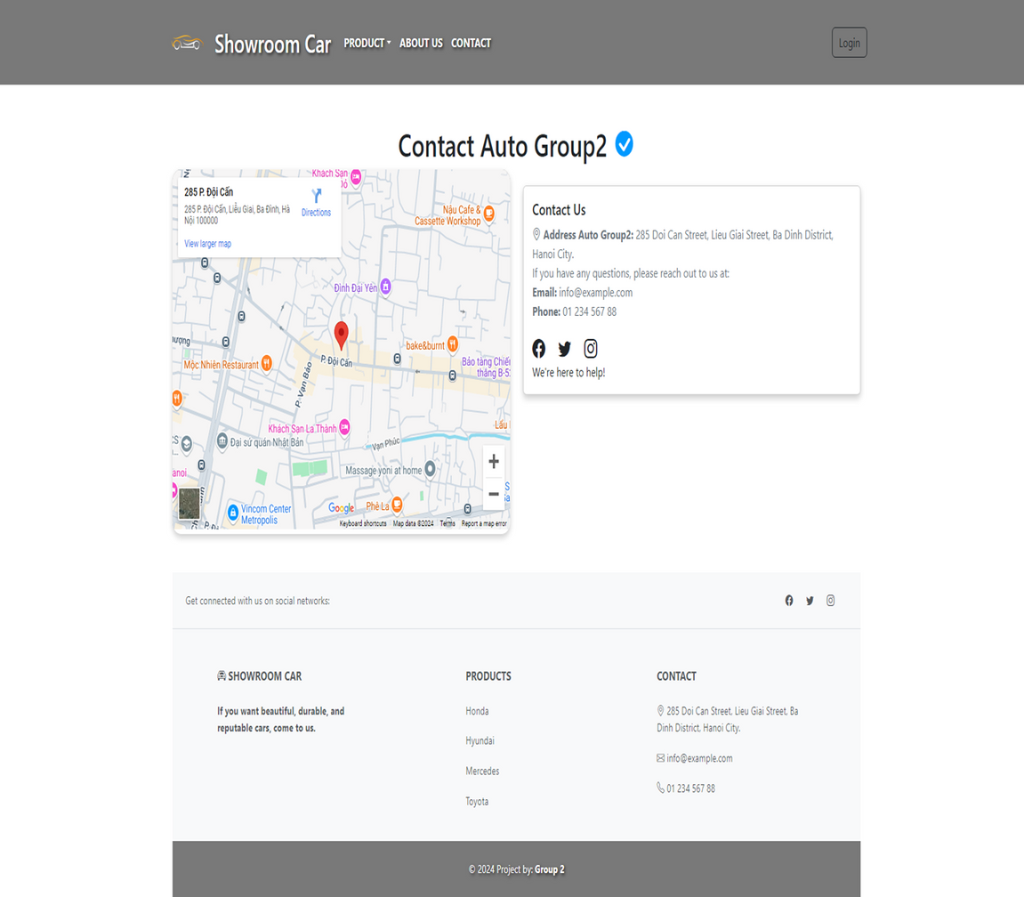
A2209G-Group 2
Home
Contact
About us
VIEW CUSTOMER

Slide 7


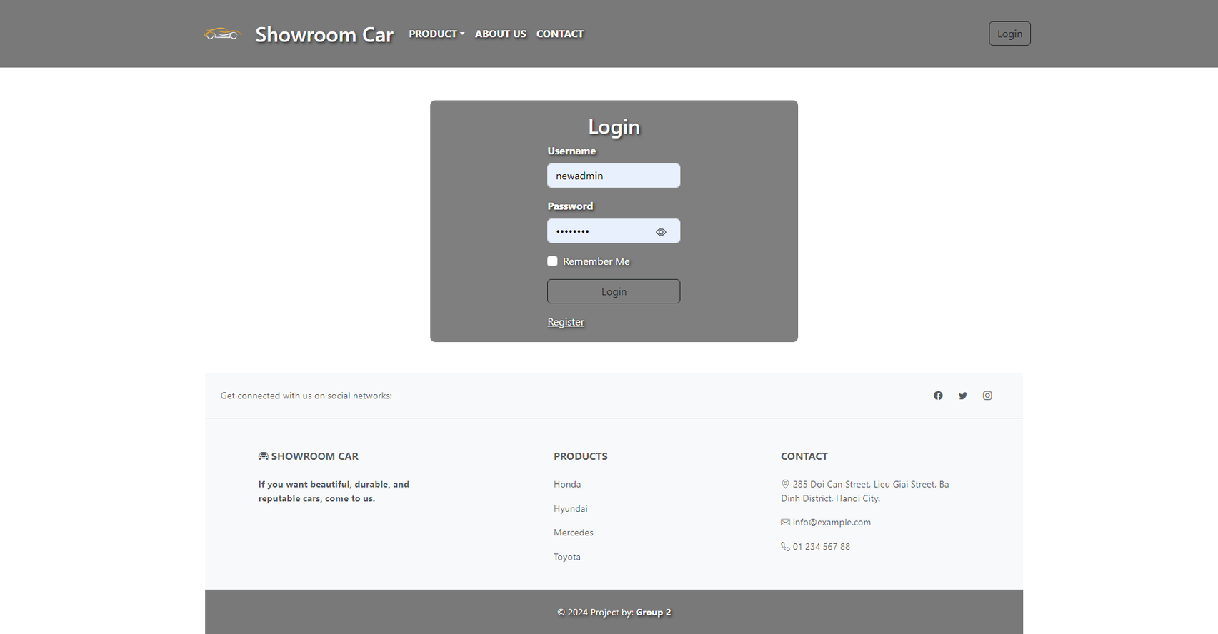
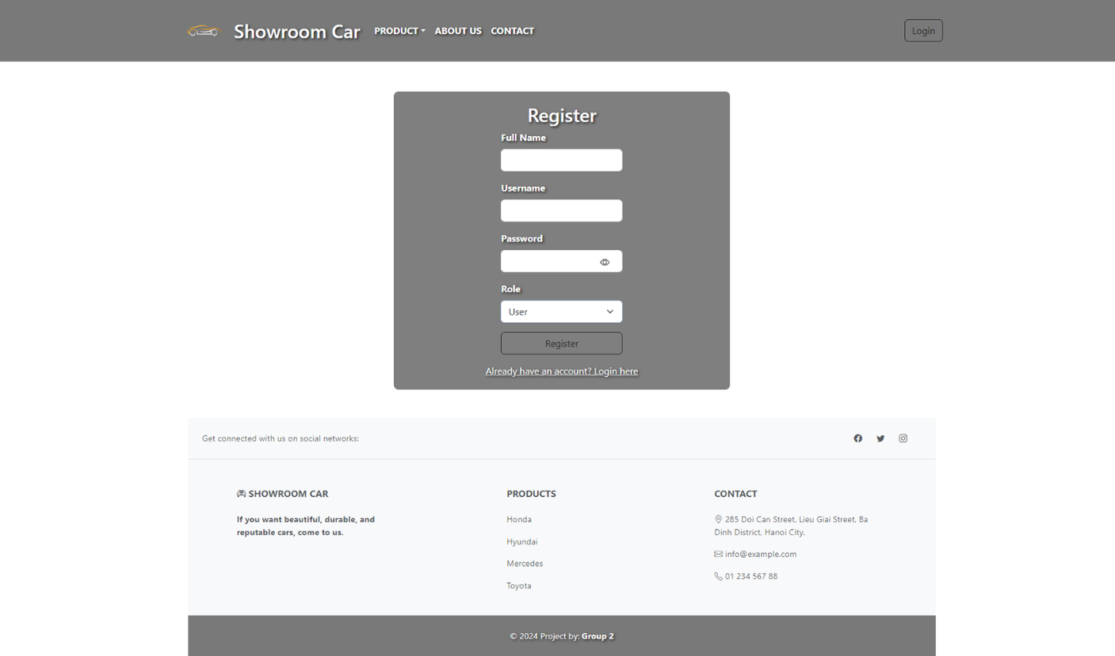


A2209G-Group 2
LOGIN-REGISTER

Slide 8
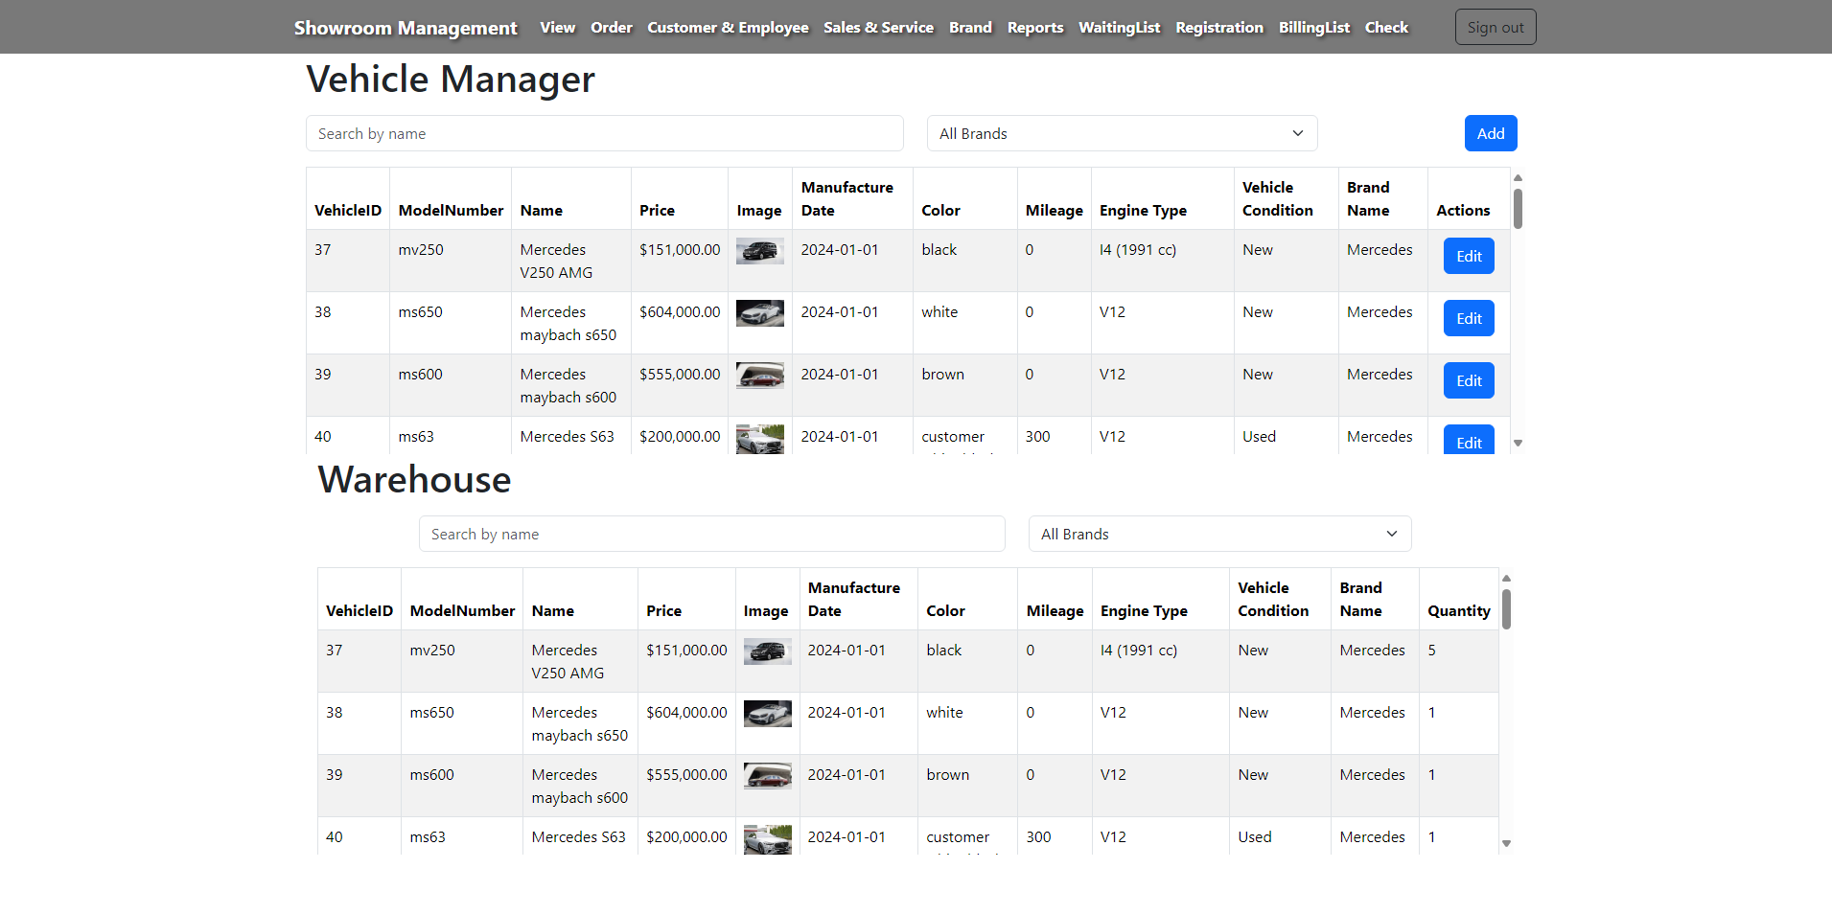
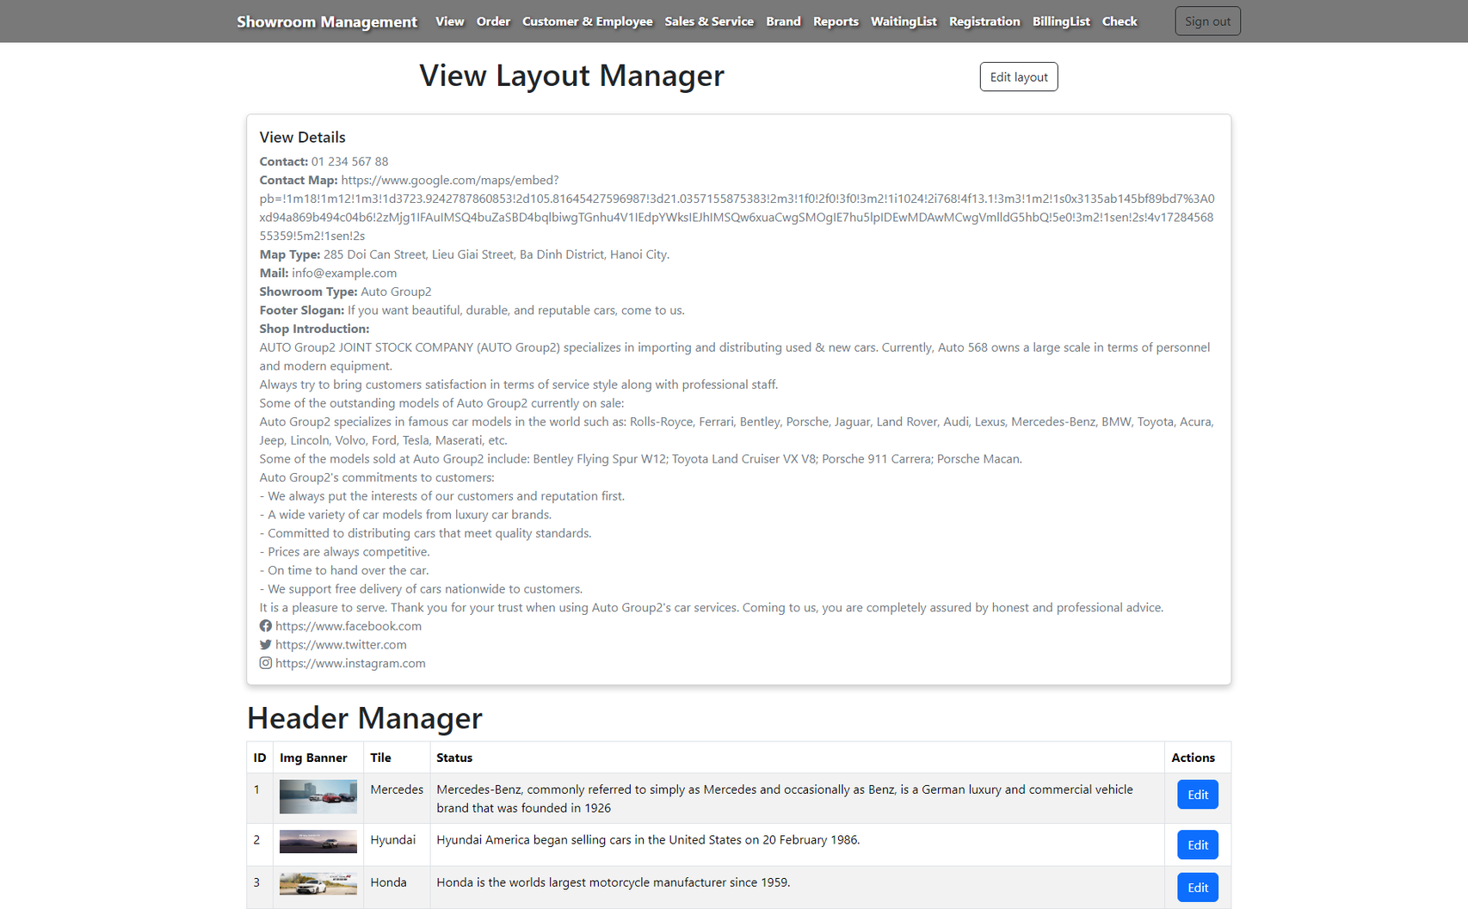
A2209G-Group 2
View Layout Manager
Vehicle Manager - Warehouse
VIEW ADMIN

Slide 9

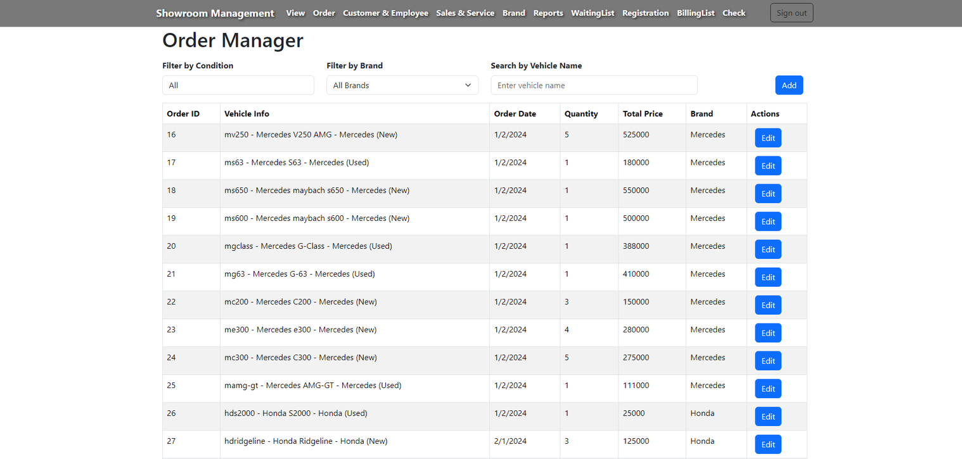
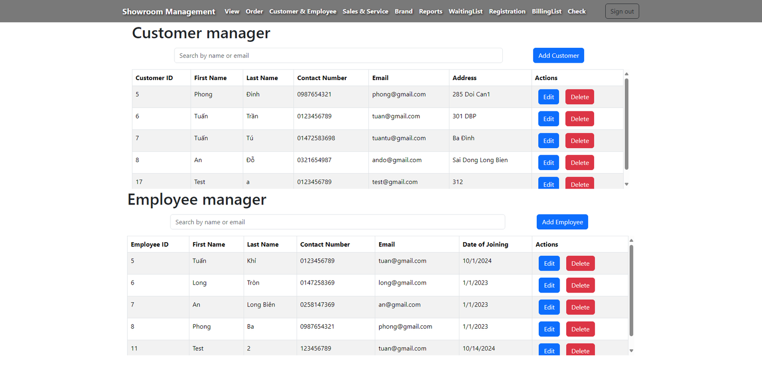
A2209G-Group 2
Customer & Employ Manager
Order Manager

Slide 10
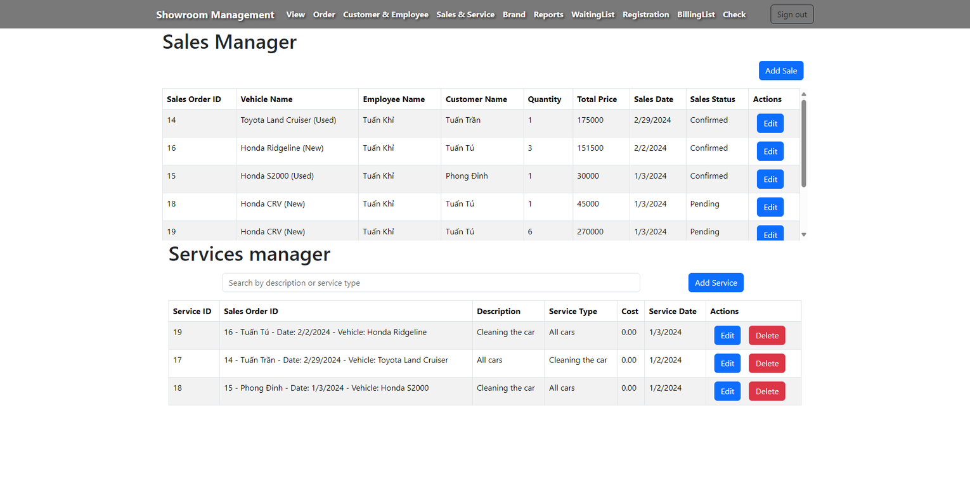
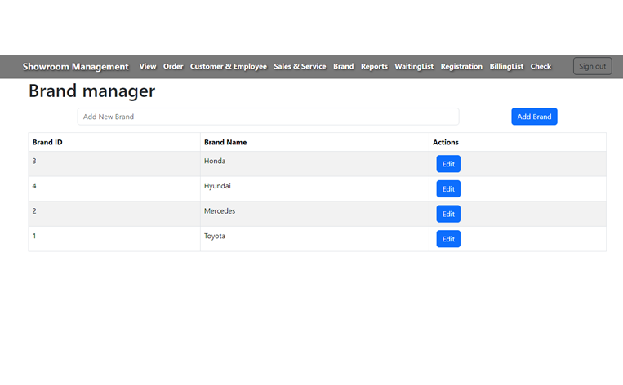
A2209G-Group 2
Brand Manager
Sale & Service Manager

Slide 11
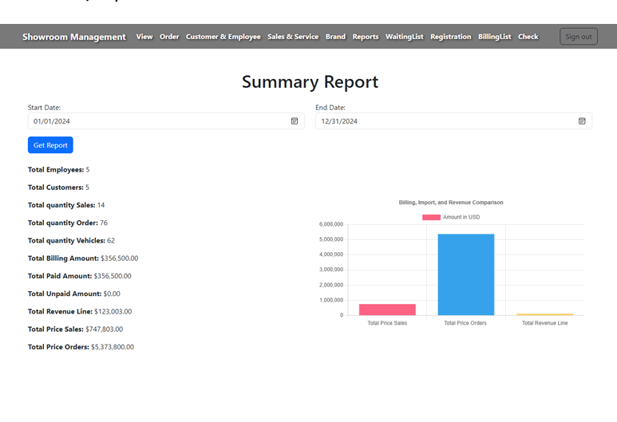
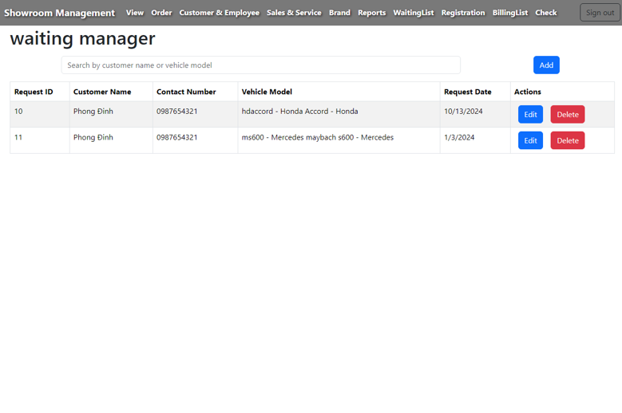
A2209G-Group 2
Waiting Manager
Reports

Slide 12
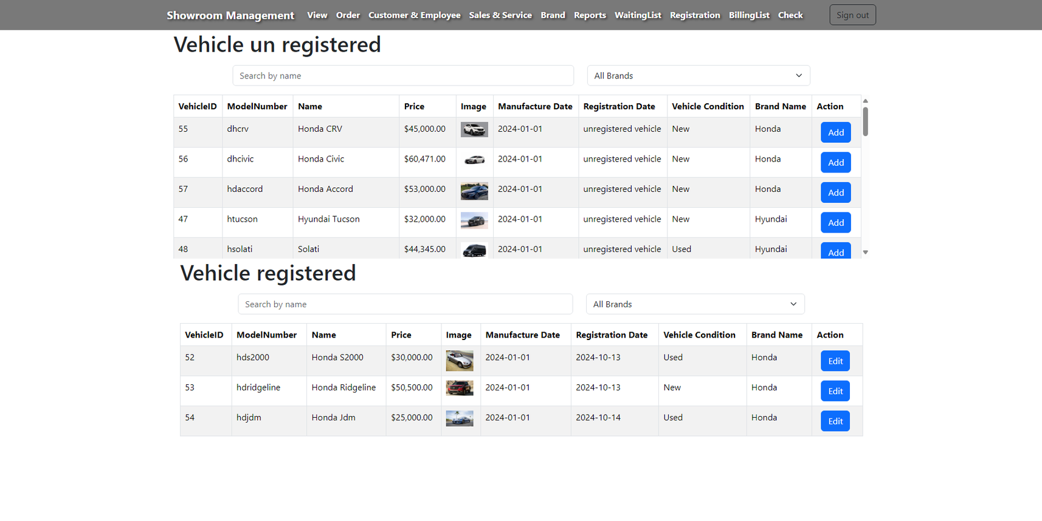
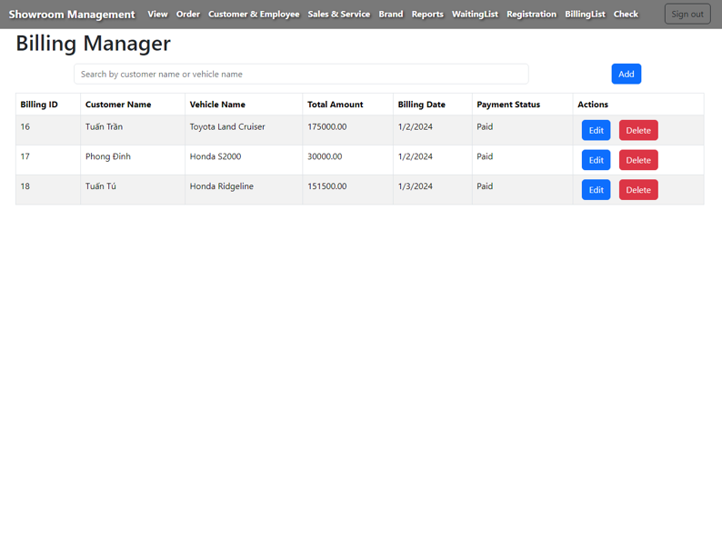
A2209G-Group 2
Billing Manager
Registration Manager

Slide 13
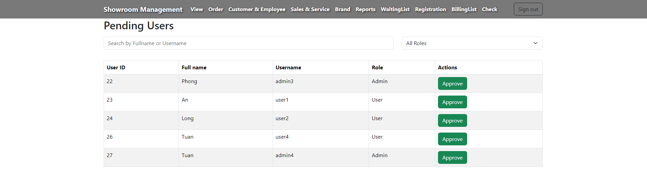
A2209G-Group 2
Check Admin & User

Slide 14
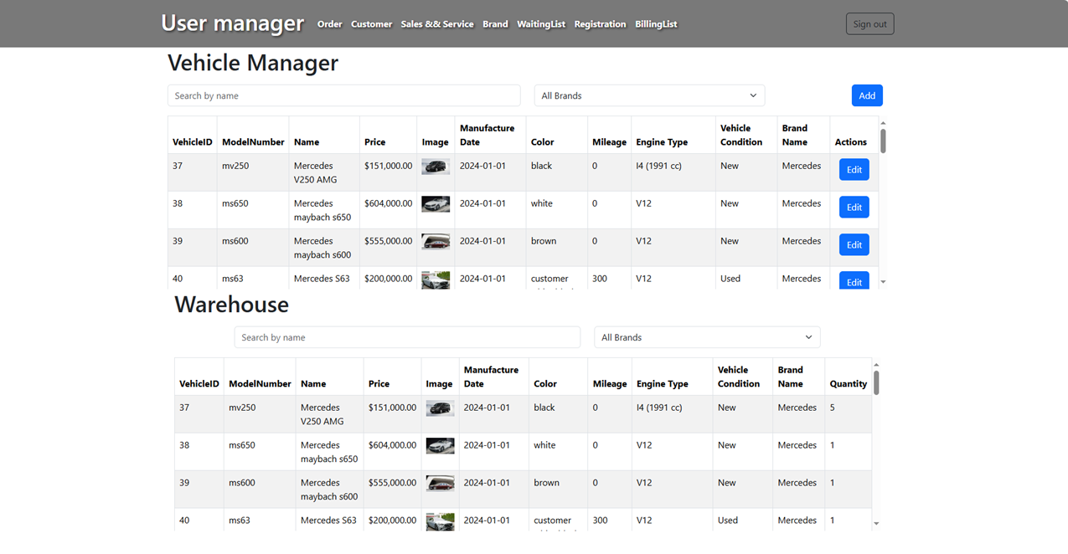
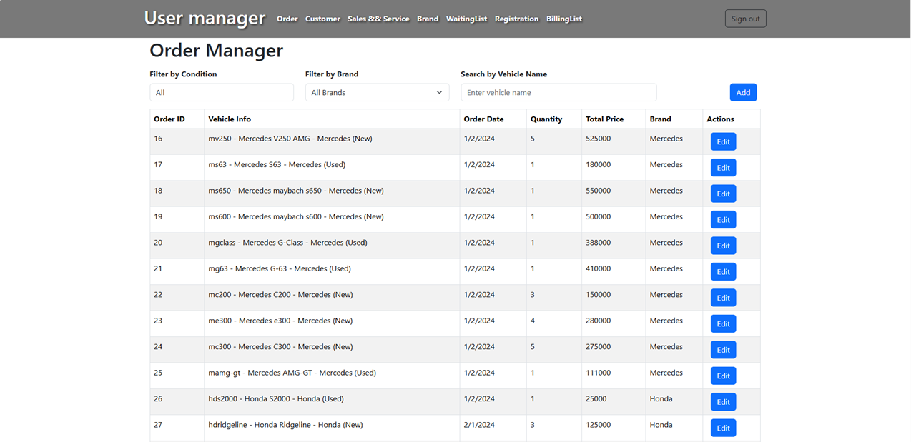
A2209G-Group 2
Order Manager
Vehicle Manager - Warehouse
VIEW USER

Slide 15
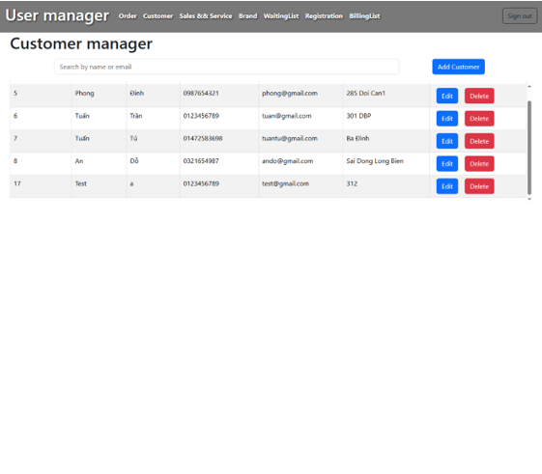
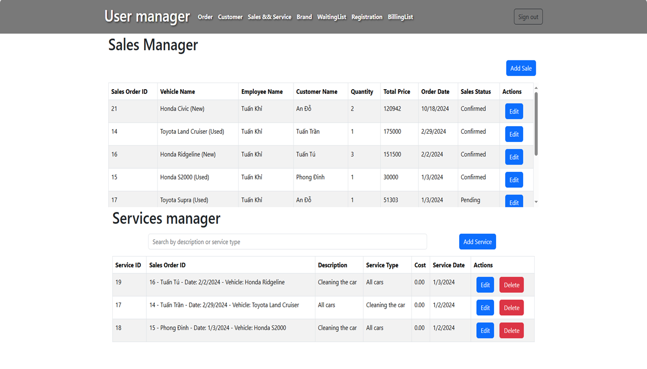
A2209G-Group 2
Sales & Services Manager
Customer Manager

Slide 16
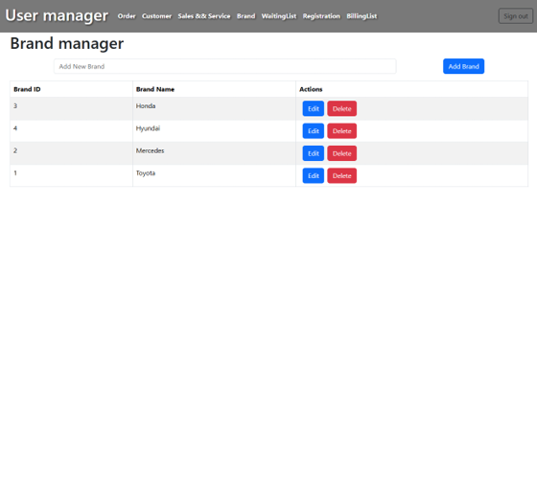
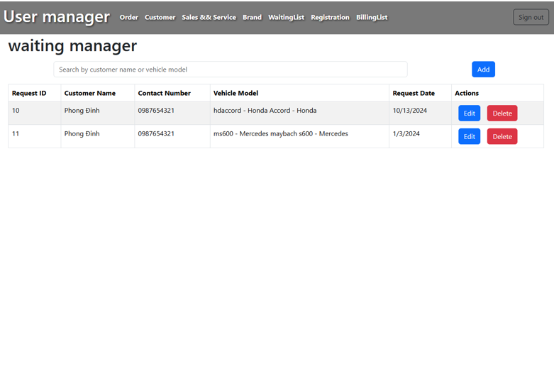
A2209G-Group 2
Waiting Manager
Brand Manager

Slide 17
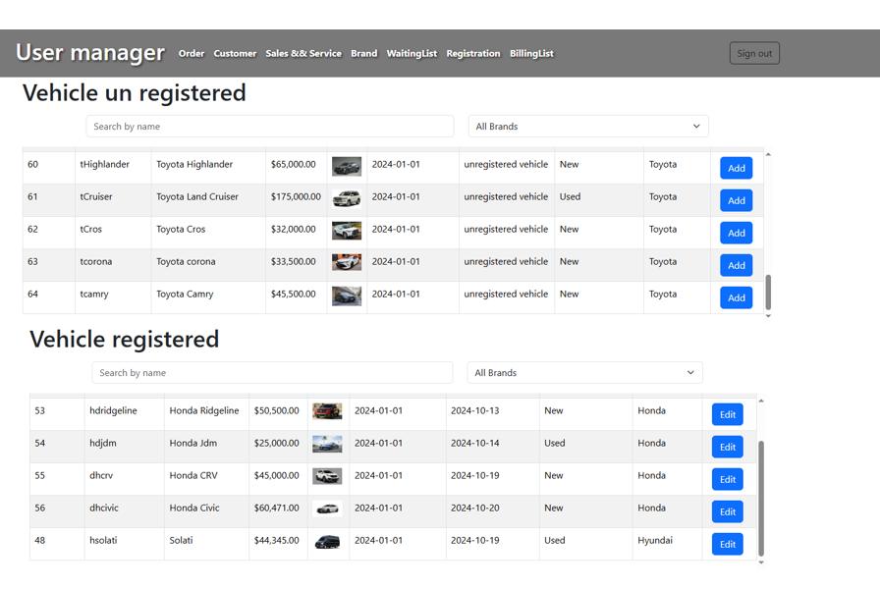
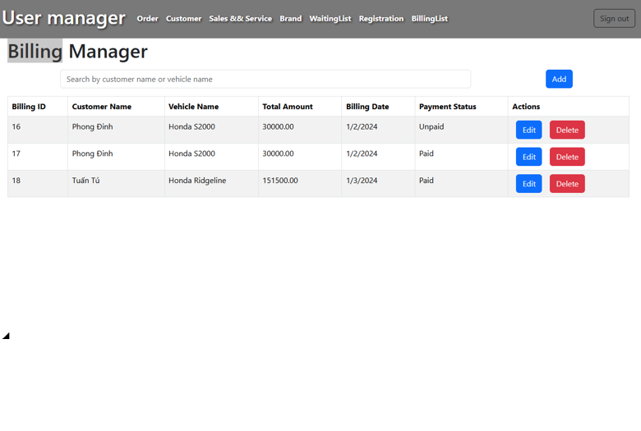
A2209G-Group 2
Billing Manager
Registration Manager

Slide 18






A2209G-Group 2
CONTACT US
0 1234 567 88
infor@example.com
www.facebook.com

Slide 19


A2209G-Group 2
THANK YOU
FOR YOUR ATTENTION

